Slide 1


Datastream Project
Project 2 : Real-time streaming application with Kafka
Option 1 Way 2 : Collect trading data using Yahoo finance API (use 1 major industry stock data for the 5 countries)
Conducted by Guillaume Marin-Bertin and Jaishan BURTON ELMO

Slide 2
Outline
Presentation of the subject
Architecture
Detail Data
Models
Demonstration
Results
Conclusion

Slide 3





I. Presentation of the subject
Objective
Develop a real-time streaming application using Kafka that collects financial data from the Yahoo Finance API.
Key Goals
Design a pipeline capable of handling both historical and real-time data streams.
Predict stock prices for major companies
Implemented Models
Batch Model: Developed using Scikit-learn for historical data.
Batch Incremental Model and Adaptive Model: Implemented using River for real-time updates.
Visualization
Results were displayed on an interactive Streamlit dashboard for real-time monitoring and evaluation.
Notes:
The aim of this project is to create a real time streaming application with Kafka, collecting financial data from Yahoo Finance API. The main goal was to design a pipeline that could handle both historical data and real-time data streams, to predict stock prices of large companies like AXA, HSBC, Toyota, Alibaba, and Google. We developed several models, including batch model with Scikit-learn and incremental adaptive models with River, while visualizing the results in an interactive Streamlit dashboard.

Slide 4
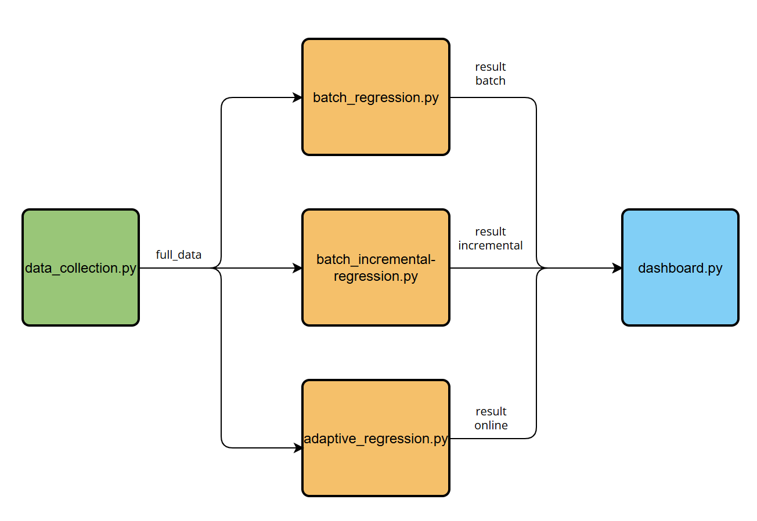
II. Architecture
Topic full_data : Retrieve data from Yahoo finance api
Topic result : Prediction and metrics
Replication factor and partition : 1

Slide 5
III. Detail Data
The data is collected every hour between September 1, 2024, and today
Open : The stock price at which the market opened for the day
Close : The last traded price during the day.
High : The highest price reached by the stock during the day.
Low : The lowest price reached by the stock during the day.
Volume : The total number of transactions during the day.
Market_cap : Total value of the entire company
Pe_ratio : Financial analysis indicator (stock price/earnings per share)
Dividend_yield : Annual dividend per share / current stock price.

Slide 6
IV. Models (1/3) – Batch Regression
Objective
Batch-based linear regression model using Scikit-learn, trained on historical data stored in CSV files.
Key Steps
Data Retrieval : From CSV files
Splits data into training and testing sets
LinearRegression to train the model and test
Kafka Integration
predicted results, true values, and metrics to the Kafka topic ‘result’

Slide 7
IV. Models (2/3) – Batch Incremental Regression
Objective
Batch-incremental regression model using on historical data stored in CSV files and online data.
Key Steps
Data Retrieval : From CSV files (before 15 November) and after from topic ‘full_data’
Splits data into training and testing sets
LinearRegression to train the model and test
Online model from 15 November
Kafka Integration
predicted results, true values, and metrics to the Kafka topic ‘result’

Slide 8
IV. Models (3/3) – Adaptive Regression
Objective
Online regression model using River, trained on online data.
Key Steps
Data Retrieval : from topic ‘full_data’
Predict the stock price
Learn from its error from prediction
Kafka Integration
predicted results, true values, and metrics to the Kafka topic ‘result’ from 30 October 2024

Slide 9

Demonstration

Slide 10
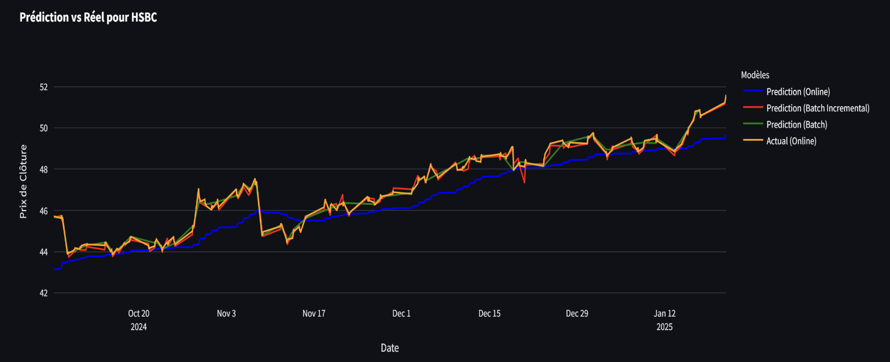
VI. Results (1/2)
Online model : the least precise
Incremental and batch model : rather precise and similar performances
Batch model : difficult to detect drift

Slide 11
Results (2/2)
Company
Online model
Batch Incremental model
Batch model
MSE
MAE
RMSE
MSE
MAE
RMSE
MSE
MAE
RMSE
AXA
0.33
0.46
0.57
0.82
0.40
0.67
0.30
0.40
0.54
HSBC
0.84
0.80
0.91
0.82
0.33
0.67
0.23
0.33
0.48
Toyota
27.52
3.32
5.27
5.45
1.83
2.04
6.30
1.83
2.51
Alibaba
12.06
2.77
3.47
3.40
1.36
1.77
3.61
1.36
1.90
Google
46.26
5.74
6.80
10.60
2.58
3.42
12.70
2.58
3.90

Slide 12
VII. Conclusion
Technical Skills Gained
Finance Knowledge: financial metrics
Tools & Programming: Python, Kafka, Streamlit
Soft Skills Learned
Teamwork
Collaboration: GitHub for version control

